Slide 1



Lecture - 4
Control Statements

Slide 2
Content
Branching Structure
    Selection Criteria
    Relational and Logical Operators
    The if-else statement
    Nested if statement
    The switch statement
Looping Structure
    Basic loop structures
    while loops and for loops
    Nested Loops
    do while loops

Slide 3
Case study
[General Math]: Solving Quadratic Equations
[Physics]: Flight of a Ball

Slide 4
Selection Criteria
if-else statement: Implements a decision structure for two alternatives
Syntax:
if (condition)
statement executed if condition is true;
else
statement executed if condition is false;

Slide 5
Selection Criteria cont.….
The condition is evaluated to its numerical value:
  A non-zero value is considered to be true
  A zero value is considered to be false
The else portion is optional
  Executed only if the condition is false
The condition may be any valid C++ expression

Slide 6
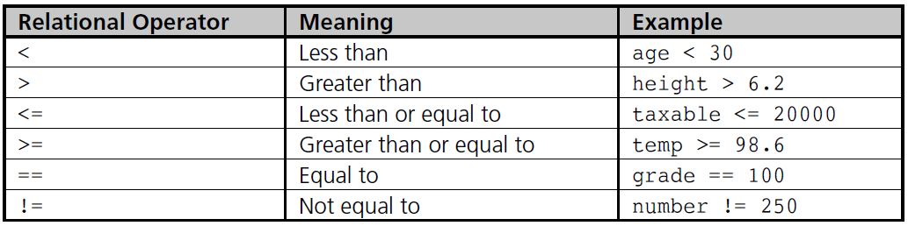
Relational Operators
Relational expression: Compares two operands or expressions using relational operators

Slide 7
Relational Operators
Relational expressions are evaluated to a numerical value of 1 or 0 only:
  If the value is 1, the expression is true
  If the value is 0, the expression is false
char values are automatically coerced to int values for comparison purposes
Strings are compared on a character by character basis
  The string with the first lower character is considered smaller

Slide 8
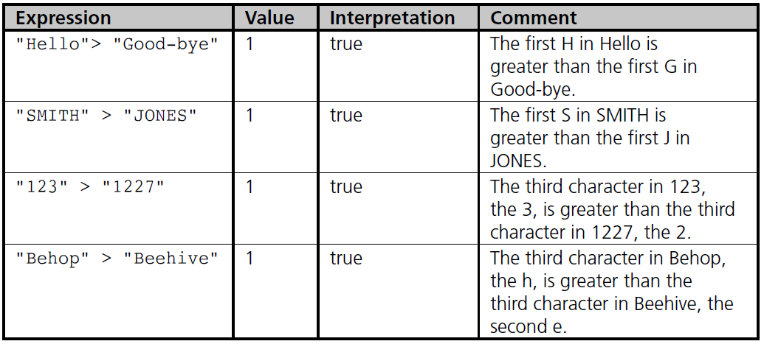
Relational Operators
Examples of string comparisons

Slide 9
Logical Operators
AND (&&): Condition is true only if both expressions are true
OR (||): Condition is true if either one or both of the expressions is true
NOT (!): Changes an expression to its opposite state; true becomes false, false becomes true

Slide 10
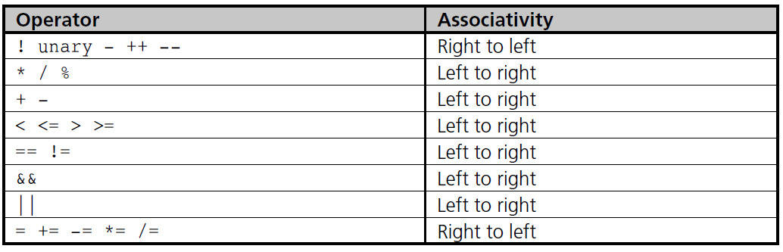
Operator Precedence

Slide 11
A Numerical Accuracy Problem
Comparing single and double precision values for equality (==) can lead to errors because values are stored in binary
Instead, test that the absolute value of the difference is within an acceptable range
Example:
  abs(operandOne – operandTwo) < 0.000001

Slide 12
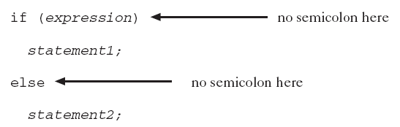
The if-else Statement
if-else performs instructions based on the result of a comparison
Place statements on separate lines for readability
Syntax:

Slide 13
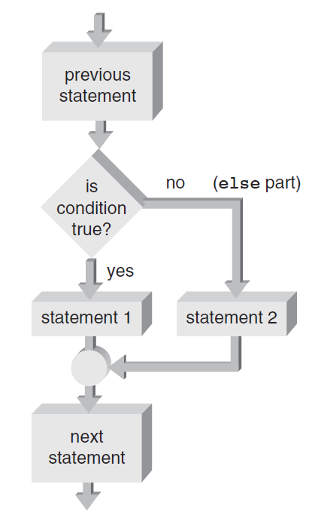
The if-else Statement

Slide 14
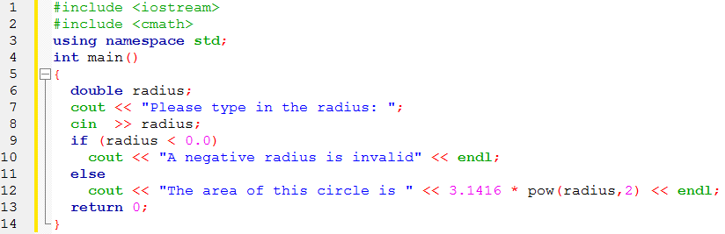
The if-else Statement

Slide 15
Compound Statements
Compound statement: A sequence of single statements contained between braces
  Creates a block of statements
  A block of statements can be used anywhere that a single statement is legal
  Any variable declared within a block is usable only within that block
Scope: The area within a program where a variable can be used
  A variable’s scope is based on where the variable is declared

Slide 16
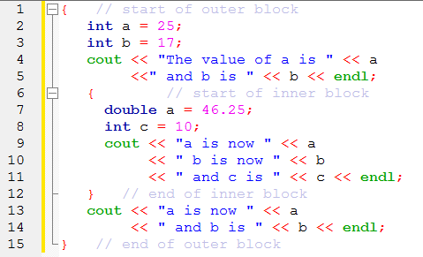
Compound Statements

Slide 17
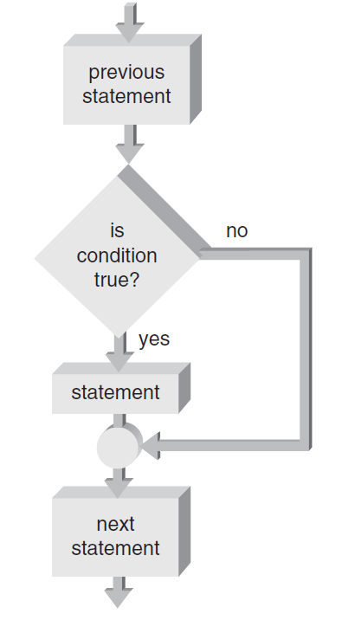
One-Way Selection
One-way selection: An if statement without the optional else portion

Slide 18
Common Problems with if-else
Misunderstanding what an expression is
Using the assignment operator (=) instead of the relational operator (==)

Slide 19
Nested if Statements
if-else statement can contain any valid C++ statement, including another if-else
Nested if statement: an if-else statement completely contained within another if-else
Use braces to block code, especially when inner if statement does not have its own else

Slide 20
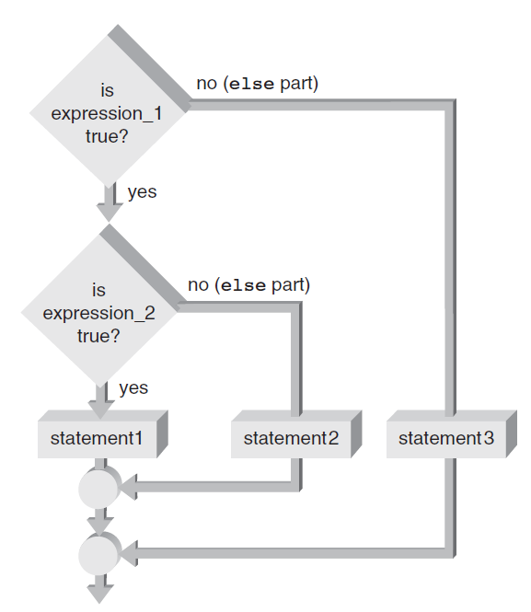
Nested if Statements

Slide 21
The if-else Chain
if-else chain: A nested if statement occurring in the else clause of the outer if-else
If any condition is true, the corresponding statement is executed and the chain terminates
Final else is only executed if no conditions were true
  Serves as a catch-all case
if-else chain provides one selection from many possible alternatives

Slide 22
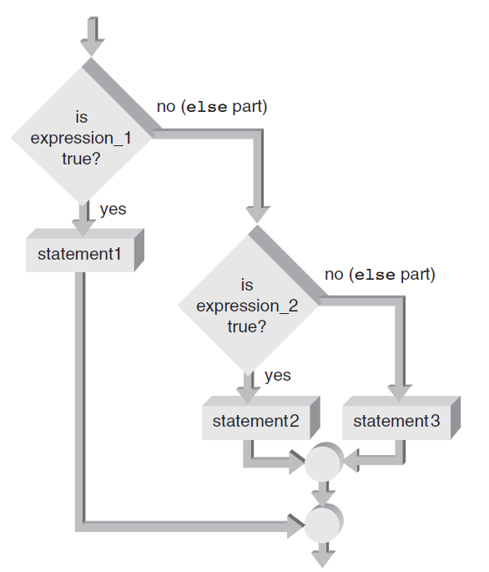
The if-else Chain

Slide 23
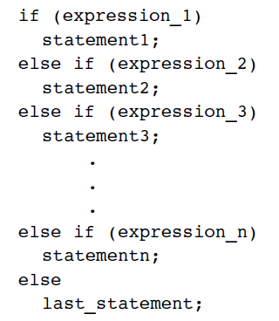
The if-else Chain
General form of an if-else chain

Slide 24
The switch Statement
switch statement: Provides for one selection from many alternatives
switch keyword starts the statement
  Is followed by the expression to be evaluated
case keyword identifies a value to be compared to the switch expression
  When a match is found, statements in this case block are executed
All further cases after a match is found are executed unless a break statement is found

Slide 25
The switch Statement
default case is executed if no other case value matches were found
default case is optional

Slide 26
Switch Statement: Example
int day = 4;
switch (day) {
case 1:
cout << "Monday";
break;
case 2:
cout << "Tuesday";
break;
case 3:
cout << "Wednesday";
break;
case 4:
cout << "Thursday";
break;
case 5:
cout << "Friday";
break;
case 6:
cout << "Saturday";
break;
case 7:
cout << "Sunday";
break;
}
// Outputs "Thursday" (day 4)

Slide 27
Case Study: Solving Quadratic Equations
Data validation: Use defensive programming techniques to validate user input
  Includes code to check for improper data before an attempt is made to process it further
Solving quadratic equations: Use the software development procedure to solve for the roots of a quadratic equation

Slide 28
Step 1: Analyze the Problem
The problem requires
  Accepting three inputs: the coefficients a, b, and c of a quadratic equation.
  The outputs are the roots of the equation, found by using the given formulas.

Slide 29
Step 2: Develop a Solution
Display a program purpose message
Accept user-input values for a, b, and c
Calculate the two roots
Display the values of the calculated roots

Slide 30
Step 2: Develop a Solution(Refining)
Display a program purpose message
Accept user-input values for a, b, and c
if a equals 0 and b equals 0 then
Display a message saying that the equation has no solution
else if a equals zero then
Calculate the single root equal to -c/b
Display the single root
else
Calculate the discriminant
If the discriminant > 0 then
Solve for both roots using the given formulas
Display the two roots
Else If the discriminant < 0 then
Display a message that there are no real roots
Else
Calculate the repeated root equal to -b/(2a)
Display the repeated root
End If
end if

Slide 31
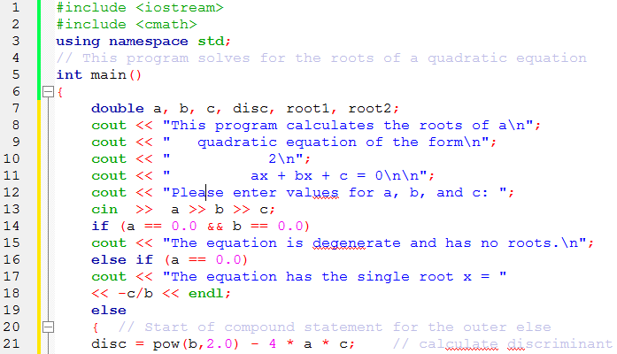
Step 3: Code the Solution

Slide 32
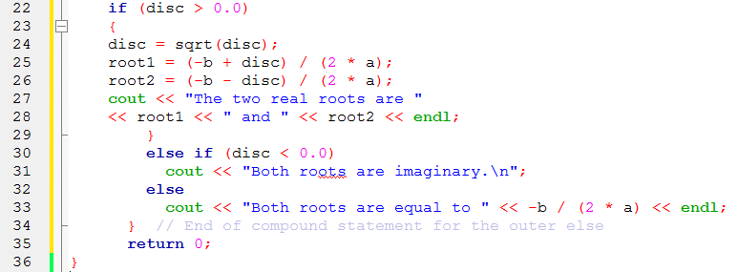
Step 3: Code the Solution

Slide 33
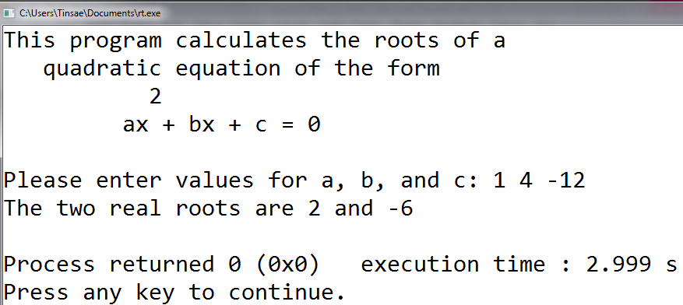
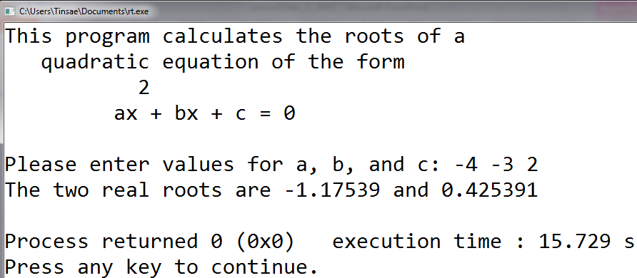
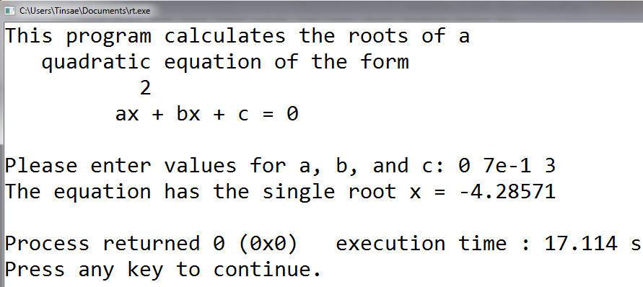
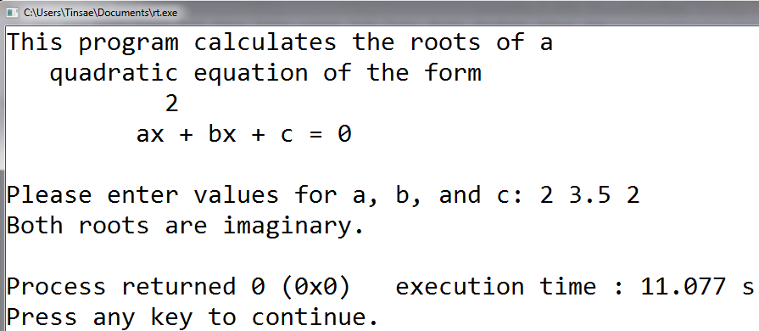
Step 4: Test and Correct the Program
Test it with different inputs
Modify the program to show imaginary roots

Slide 34
Basic Loop Structures
Repetition structure has four required elements:
  Repetition statement
  Condition to be evaluated
  Initial value for the condition
  Loop termination
Repetition statements include:
  while
  for
  do while

Slide 35
Basic Loop Structures
The condition can be tested
  At the beginning or Pretest
  At the end or Posttest
Something in the loop body must cause the condition to change
  to avoid an infinite loop , which never terminates

Slide 36
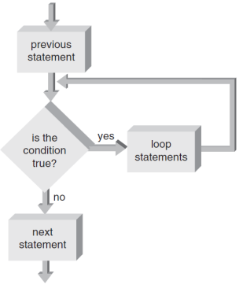
Pretest and Posttest Loops
Pretest loop:
  Condition is tested first;
  if false,
    statements in the loop body are never executed
while and for loops are pretest loops

Slide 37
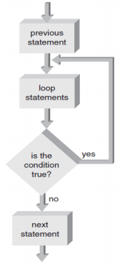
Pretest and Posttest Loops
Posttest loop:
  Condition is tested after the loop body
  statements are executed;
loop body always executes at least once
do while is a posttest loop

Slide 38
Fixed-Count versus Variable Condition Loops
Fixed-count loop: Loop is processed for a fixed number of repetitions
Variable-condition loop: Number of repetitions depends on the value of a variable

Slide 39
while loops
while statement is used to create a while loop
– Syntax:
while (expression)
statement;
Statements following the expressions are executed as long as the expression condition remains true
A non-zero value is true

Slide 40
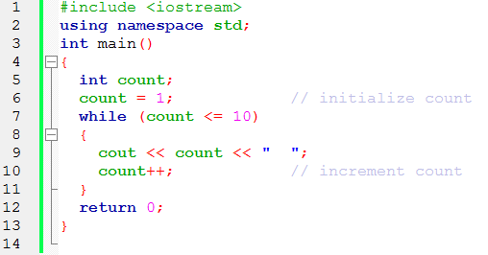
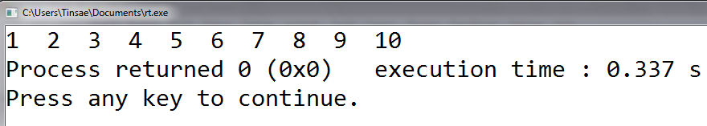
while loop example

Slide 41
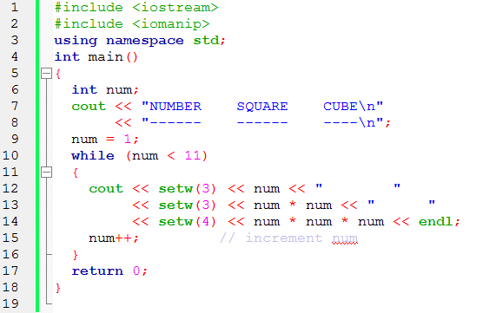
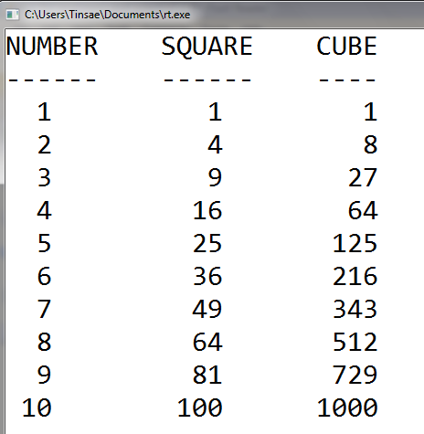
while loop example
A program to display the square and cube of numbers 1 up to 10

Slide 42
break statement
Forces an immediate break, or exit, from switch, while, for, and do-while statements
Violates pure structured programming
  but is useful for breaking out of loops when an unusual condition is detected

Slide 43
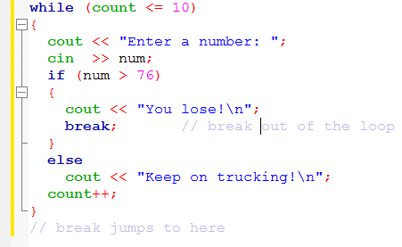
break statement example

Slide 44
continue statement
Applies to while, do-while , and for statements;
causes the next iteration of the loop to begin immediately
Useful for skipping over data that should not be processed in this iteration
  while staying within the loop

Slide 45
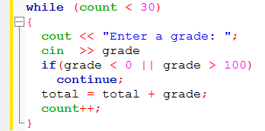
continue statement example
A continue statement where invalid grades are ignored, and only valid grades are added to the total:

Slide 46
for loops
A loop with a fixed count condition that handles alteration of the condition
Syntax:
for (initializing list; expression; altering list)
statement;
Initializing list
  Sets the starting value of a counter
Expression
  Contains the maximum or minimum value the counter can have;
  determines when the loop is finished
Altering list
  Provides the increment value that is added or subtracted from the counter in each iteration of the loop

Slide 47
for loops
If initializing list is missing
  the counter initial value must be provided prior to entering the for loop
If altering list is missing
  the counter must be altered in the loop body
Omitting the expression will result in an infinite loop

Slide 48
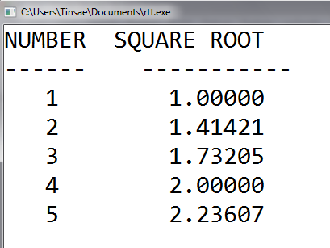
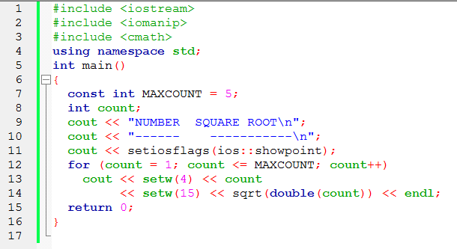
for loop example

Slide 49
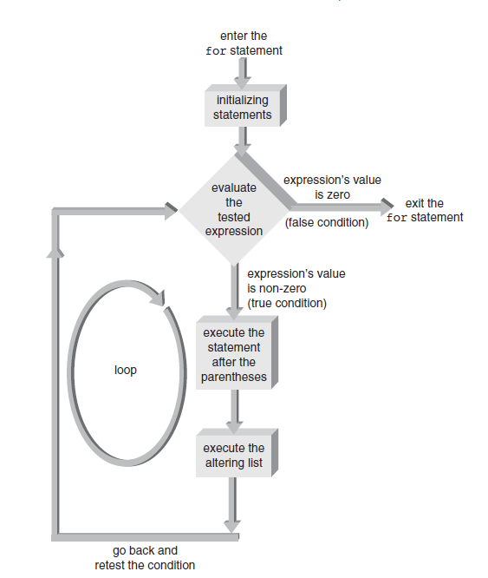
For Loop Flow of Control

Slide 50
Nested Loops
A loop contained within another loop
  All statements of the inner loop must be completely contained within the outer loop; no overlap allowed
  Different variables must be used to control each loop
  For each single iteration of the outer loop, the inner loop runs through all of its iterations

Slide 51
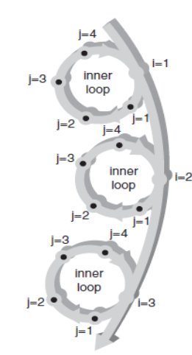
Nested Loops Diagram
For each i, j loops

Slide 52
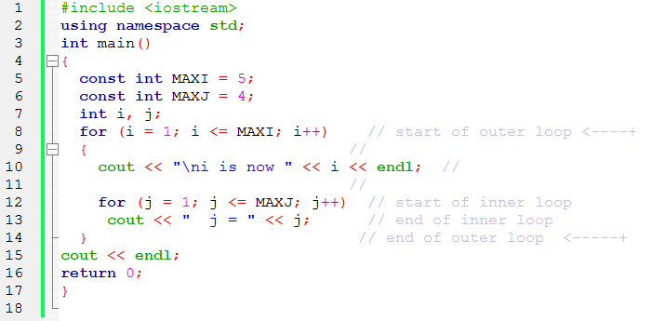
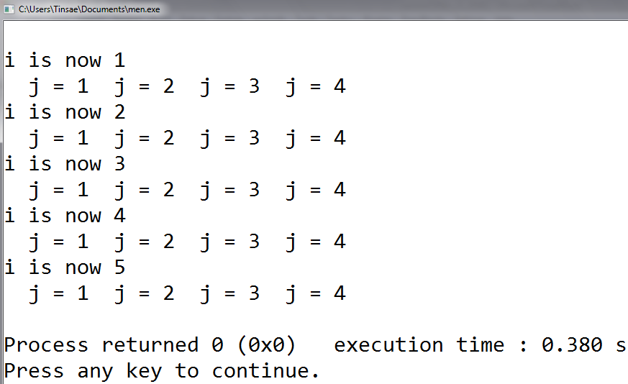
Nested Loops Example

Slide 53
do while loop
Loop continues while the condition is true
Condition is tested at the end of the loop
Syntax:
do
statement;
while (expression);
All statements are executed at least once in a posttest loop

Slide 54
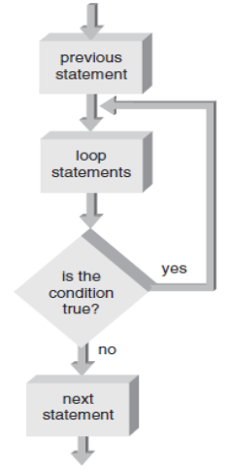
do while loop flowchart

Slide 55
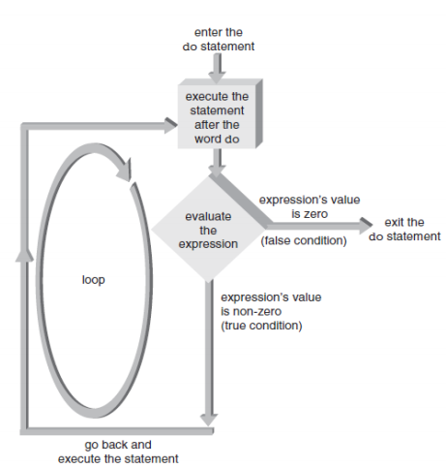
do while loop flow of control

Slide 56
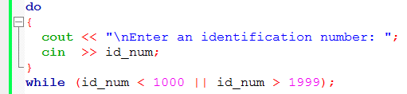
common use of do while loop
Useful in filtering user-entered input and providing data validation checks
Can enhance with if-else statement

